Slide 1


Design and Development of Smart Water Purification Level Tester for Visually Impaired Person
8th International Workshop on Computer Science and Engineering (WCSE 2018) to Bangkok, Thailand
Presented by:
Md. Khabbab Hossain Tusher
East West University
Department of Computer Science and Engineering
Dhaka-1212,Bangladesh

Slide 2
Summary
Introduction
Existing devices for blind people
Water purification tester (existing)
Our proposed system
System testing
Conclusion and future plan

Slide 3
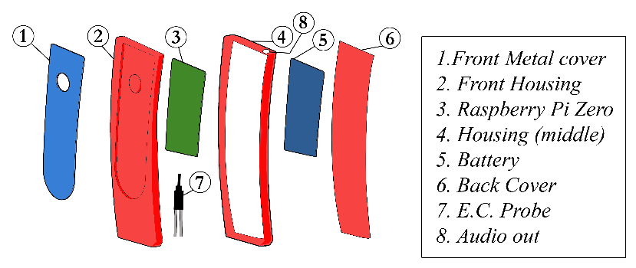
Introduction
Vision Impairment is one of such a kind physical disability that many people have around the world.
Those data are collected from WHO.
Smart device for them for determining the purity level of drinking water based on conductivity properties.
We have a plan to extend this device as a liquid identification (any liquid substance) meter for blind person.
Some sort of VI | 253M
Near VI | 1.1B
Totally Blind | 36M
Age 50+ | 81%
Age less then 15 | 19M
Working in Ireland | 16%
Other Work | 41.36% and 33%

Slide 4
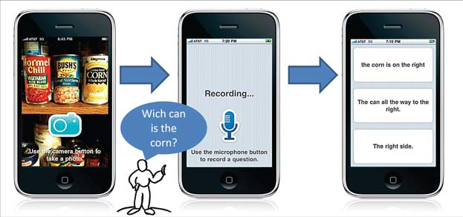
Overview of Existing Device For Blind People
1.VizWiz Social
Social app for helping visually impaired people.
Helping by question answering
5000 active user

Slide 5
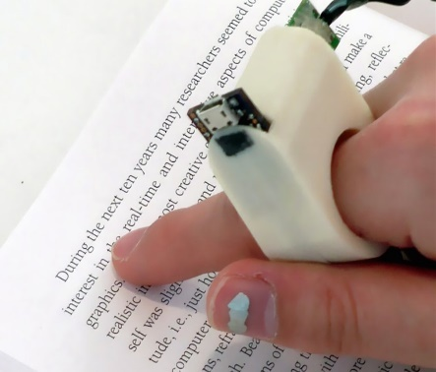
Overview of Existing Device For Blind People
2. FingerReader
The Finger Reader Device of MIT
Prototype state (under research) .
Wearable device
Read the printed lines during the movement of the device

Slide 6
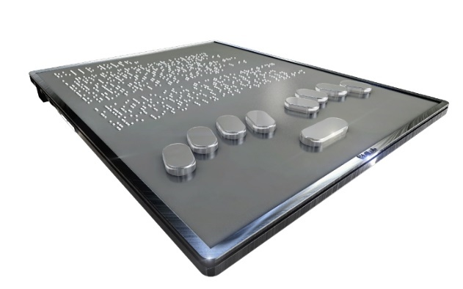
Overview of Existing Device For Blind People
3. Bitlab
The Bitlab tablet
First tablet for blind people.
start selling for about $500
This device easily performs the communication with personal computer via serial port

Slide 7
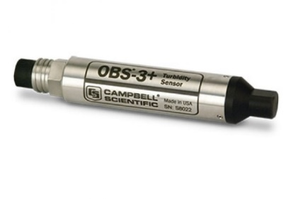
Overview of Existing Devices for Measuring Water Purification level
1. OBS-3+ Turbidity Sensor
the transparent level of the water
It uses light transmittance and sees the scattering rate and then checks the turbidity

Slide 8
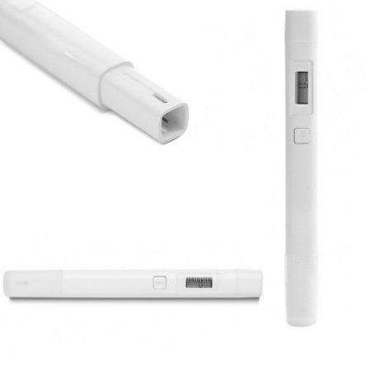
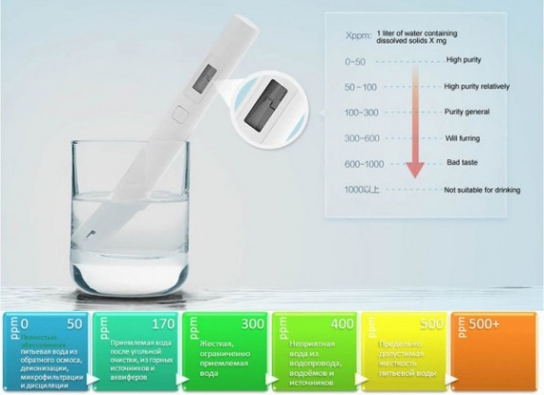
Overview of Existing Devices for Measuring Water Purification level
2. Xiomi TDS Pen
. It measures total dissolved solid in water through the conductivity properties of water

Slide 9
Proposed System Design and Implementation
Hardware and Software Components
The main component of our system is designing the conductivity sensor or conductivity probe for measuring the conductivity level of water
Meter Calibration and Testing
The accuracy of any sensor/meter (in our case, EC probe), depends on calibration
Lets discuss our Technique in details

Slide 10
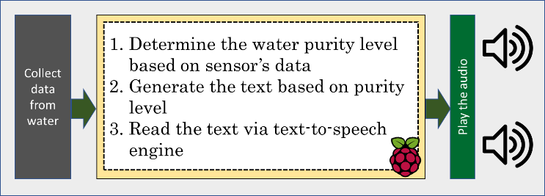
Proposed System Design and Implementation
Hardware and Software Components
Pure Silver Wire
10K register
The microcontroller (in our case raspberry pi)
Python script for collecting and processing the data.
Fig. : The data flow diagram

Slide 11
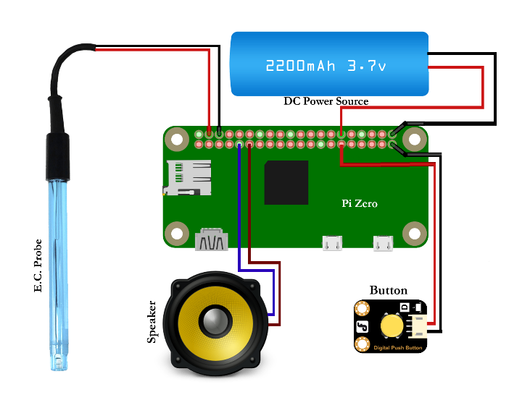
Proposed System Design and Implementation
Hardware and Software Components
Pure Silver Wire
10K register
The microcontroller (in our case raspberry pi)
Python script for collecting and processing the data.
Fig. : The circuit diagram of the system.

Slide 12
Proposed System Design and Implementation
Hardware and Software Components
Table 1: The hardware components list
Name of the components | Purpose
Raspberry Pi Zero [8] | The main controlling board
Speaker | For audio output
EC. Probe | For collecting conductivity data
Battery | Power source
Push button | For testing/on/off

Slide 13
Proposed System Design and Implementation
Hardware and Software Components
Meter Calibration and Testing
We choose distilled water as standard pure water, since distilled water does not contain any minerals.
A thermometer is needed for recording the water temperature during the calibration process.
Standard TDS meter.
result is compared with standard TDS meter’s reading (available in the market).

Slide 14
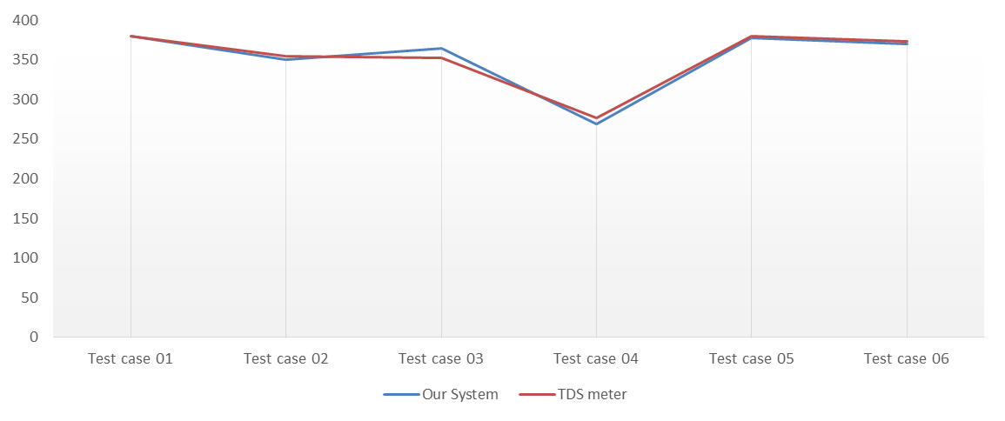
Proposed System Design and Implementation
Hardware and Software Components
System Integration
The whole system is integrated together with all the hardware components as shown in the circuit diagram
We used the open source text to speech engine for reading the text

Slide 15
Conclusion
In Conclusion:
The design and implementation of water purification measurement device are presented. The conceptual device design is also included in this paper. This smart device is useful for blind people which may reduce the complexity of their lives with respect to water purification level measurement. This device is also used as a water purification tester for robotics system (service robot). We have a plan to extend this device as a liquid identification (any liquid substance) meter for blind person.
Future Work:
Mobile based purification tester(E.C.Probe) for visually impaired person as well as planning to extend this device for all type of liquid substance detection and recognition system. Additionally, integrate this device with service robot for as water purification testing sensor.

Slide 16
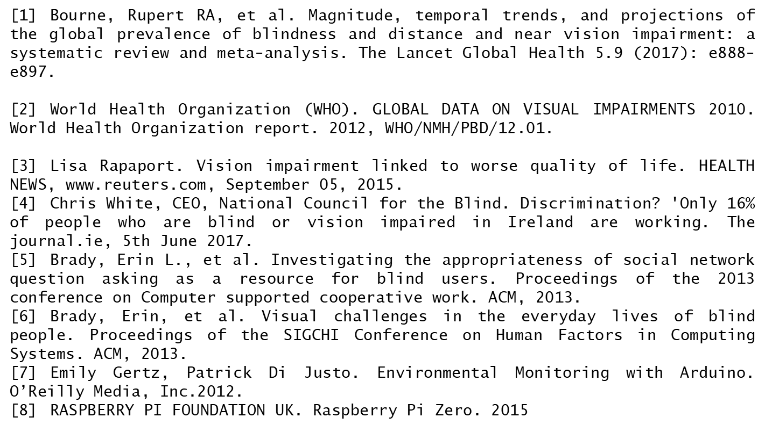
References

Slide 17

Thank you
for your attention
A/2, Jahurul Islam Avenue | Jahurul Islam City | Aftabnagar |
Dhaka-1212 | Bangladesh
www.ewubd.edu

